Slide 1
Open-IX RIPE 68 Warsaw, Poland
Fearghas McKay

Slide 2
Why? … through Standards
To professionalize IXPs …
To foster data center competition…
To help reduce costs …
To implement The Community Model …
To develop real data center neutrality …
To substantiate (and embrace) the Euro-interconnect model (theology + model) …

Slide 3
Overview
Global Round-Up
138 Dues Paying Members
10 Pending New Members
16 Certified Data Centers
2 Certified IXPs (NY, VA)
Pending Data Centers = 5
EdgeConnex (Houston USA)
Vantage (Santa Clara USA)
Sentinel (Chicago USA) x 2
DuPont Fabros (New Jersey)
Pending IXPs = 2
Omaha-IX (Omaha USA)
Phoenix-IX (Phoenix USA)

Slide 4
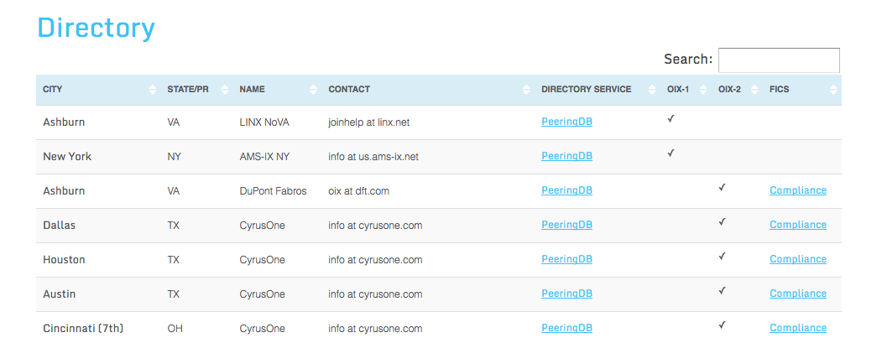
Directory
Data Centers and IXPs
Pointer to more detailed entries (their choice)
Links to required compliance documents
Directory = http://www.open-ix.org/directory

Slide 5
What happened so far?
Data Center Competition
Market to Market interconnect pricing
Focusing on space + power, real neutrality
More choices
IXP Competition
Community Model working
Normalization of costs
Traffic Growing

Slide 6
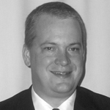
OIX Standing Committees
IXP STANDARDS
GROUP
DATA CENTER
STANDARDS GROUP
MEMBERSHIP
Henk Steenman
Board Liaison
Gabe Cole
Board Liaison
Christian Koch
Board Liason

Slide 7
Get Involved: Membership
Membership has privileges
US$50
Right to vote
Right to run for election
Right to participate in certification process
Right to serve on committees
Right to shape the future of the Association
Right to members only access

Slide 8
GET INVOLVED
Go here to get involved
http://www.open-ix.org

