Slide 1
Crowdsourcing & split-tunneling to map and circumvent URL filtering
Walid Al-Saqaf
Örebro University - Sweden
A presentation for RIPE 68
Warsaw, May 14

Slide 2
Two parallel tracks using Alkasir
Mapping URL filtering through crowdsourcing
- Reporting of suspected filtered URLs
Manual submissions & automatic cross-validation with crowdsourcing
-
Who is blocking? Autonomous Systems or Internet Service Providers?
Crowdsourcing to identify similar response patterns to HTTP requests
2) Circumventing filtering through SSH split-tunneling
Develop an effective and affordable circumvention method
Users to circumvent and also provide data
Analysis of user behavior in reporting about censorship

Slide 3
1) Mapping URL Filtering
Manual entry of URL (one time process)
If filtering identified (to be explained in the next slide)
Automatic crowdsourcing triggered for other users in the same country
Content analysis using statistical software (SPSS)

Slide 4
URL Submissions
DEMO
User reports a URL manually
Software verifies –using server- by comparing headers and/or content with remotely fetched version of the same URL
If found to be blocked, the moderator verifies if the URL is not of porn/nudity content (if approved before, it is approved automatically & vice versa)
Moderator is a closed group and public access is limited due to personal risk
Assessment of what is porn and what is not is based on meta website data
Entry is added to the database with relevant data accordingly
Requests to clients of other users using the same AS/ISP are sent to also check whether the URL is filtered (all in the background)*
If multiple clients confirmed the filtering, the request is sent to clients of other users in the same country but using other ISPs*
Note: It is also possible to check manually entered URLs in any country/ISP in background
* Under development

Slide 5
How to know if a URL is filtered (assuming right IP address reached, i.e., no DNS tampering occurred)
Different HTTP response status code (403, 504…)
(exception: redirections to localized versions or forbidden by the source due to geo-location …)
No header response
(connection dropped)
?
200 but with different HTTP header response
(e.g., common firewall signatures [Websense, SmartFilter, etc.], significantly different content size
Substantial modified content
check the first 1000k and compare text (not bullet-proof)

Slide 6
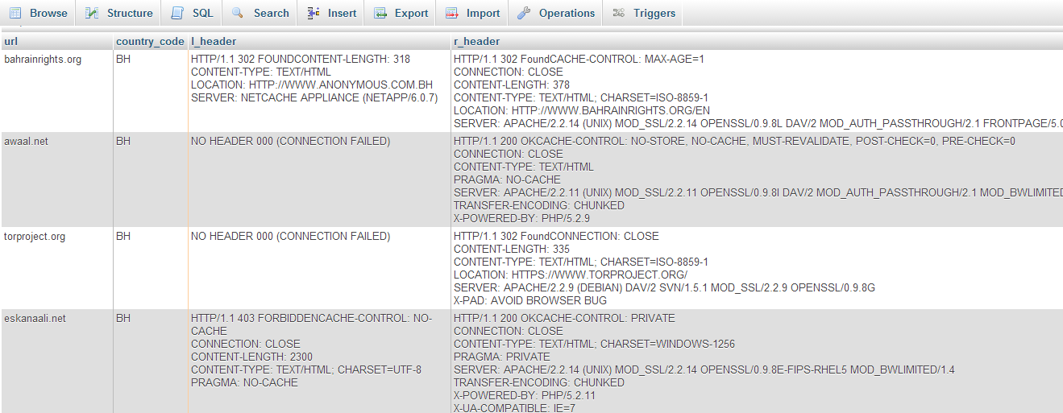
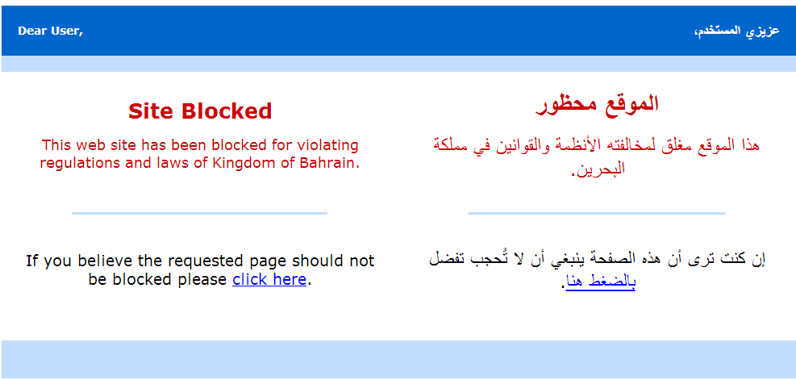
Example: Bahrain, same ISP
No consistency
& no transparency

Slide 7
Benefits of source-crowding
Maximizes productivity by giving users the chance to decide what filtered URLs they want to access
Enhances reliability through cross-validation based on location
Allows testing and verifying any URL virtually any time and anywhere an Alkasir client is running
When enabled, can track the level and depth of filtering through automatic addition of externally linked URLs in a reported document

Slide 8
2) Circumventing URL Filtering
Socks local proxy activated after connecting to SSH server (SSL and obfuscated/normal Putty) with local dynamic port (AES CBC enc for SSH2)
A pool of 100+ proxy IPs available (different class B addresses)
Proxy automatic configuration file that is retrieved when Alkasir is connected is used to divert traffic as required (split-tunneling)
Remote DNS resolution enabled to prevent DNS leaks
Alkasir.com is always accessed through the encrypted tunnel
Blank alkasir.pac file:
function FindProxyForURL(url,host)
{
if (shExpMatch(host, "*alkasir.com*"))
{
return "SOCKS5 127.0.0.1:<local PORT>;
DIRECT";
} return "DIRECT";
}

Slide 9
The split-tunneling approach
Alkasir user
Encrypted
& tunneled
(hidden from ISP)
Regular (exposed to ISP)
UNCENSORED
The PAC file is built based on the geo-location of the client retrieved through ip2location (paid service) with the IP as input

Slide 10
Benefits of split-tunneling
Utilizes bandwidth on the server and client efficiently
Allows users to access localized services, news normally
Reduces the risk of proxy-use detection by the ISP
Encourages reporting more filtered URLs, moderators to learn more about filtering methods and content
Can serve as an additional plug-in for other circumvention tools (utilizing the list of blocked URLs)
Encourages the updating of empirical data on filtering for use by advocacy groups, scholars, and users

Slide 11
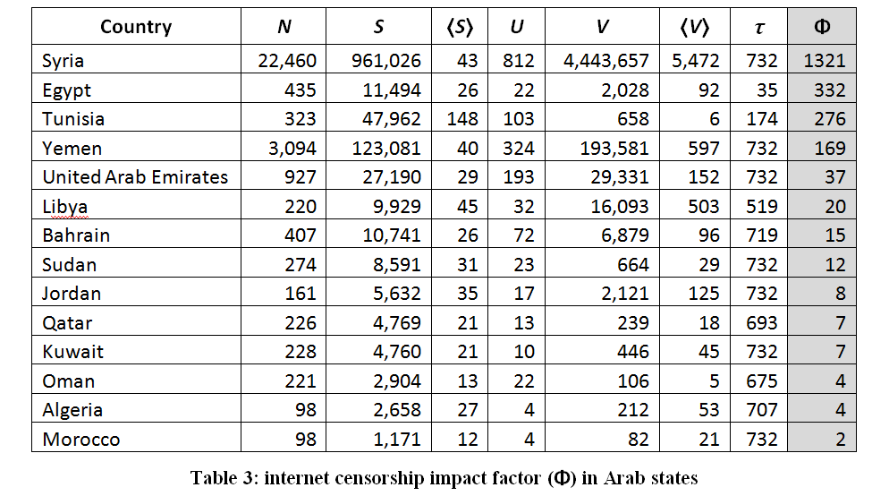
Deriving the sample (1/10/2010-1/10/2012)

Slide 12
Server data shows: Filtering patterns corresponded to political developments
A combined graph showing the number of URL reports for the four case studies (Tunisia, Egypt, Yemen, and Syria)

Slide 13
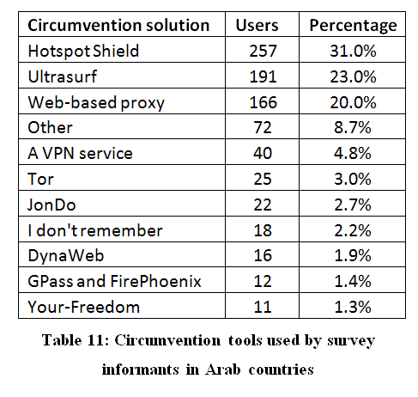
Survey: Most widely used circumvention tools

Slide 14
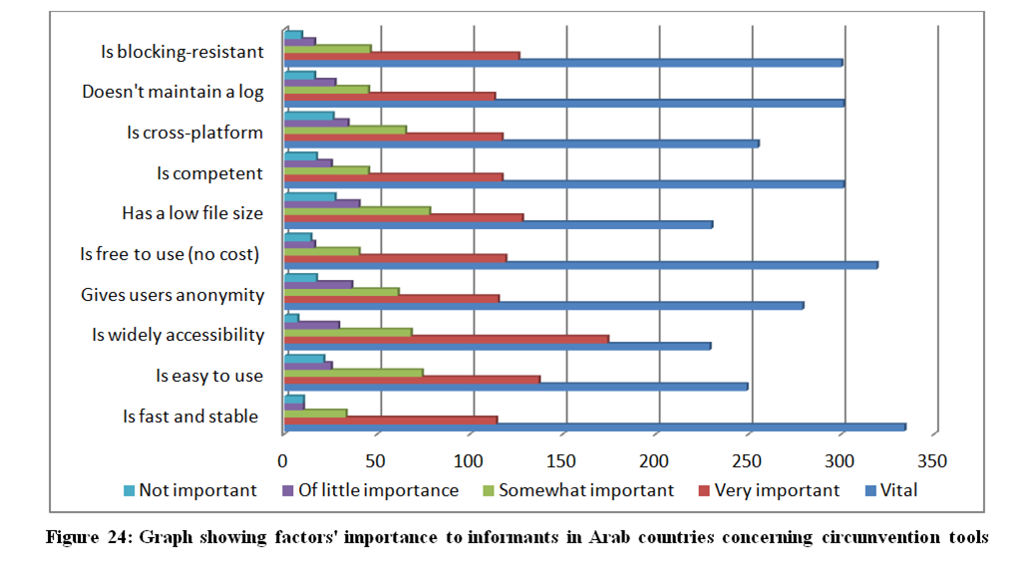
Survey: What is needed for better circumvention

Slide 15
Future work and ambitions
Enhancing Alkasir’s blocking-resistance
Developing extensions for browsers and apps for mobile devices
Reducing risks to users, ensuring lack of personal data and enhancing split-tunneling to prevent detection of proxy use
Adding multiple circumvention methods (e.g., VPN, web-based…)
Building an API to allow access to data (requires risk assessment)
Defining a more concrete & systematic categorization approach
Cooperating with like-minded projects to improve reliability of data (Herdict, OpenNet Initiative, Choke Point)
Proposing the integration of Alkasir’s data into other popular circumvention tools (Tor, Psiphon, etc.) to enable split-tunneling

Slide 16
Questions

