Slide 1
Historical Institutionalism and the Quest of Developing Countries for an ITU-based IP Address Allocation Regime
Samson Esayas, researcher at the Norwegian Research Center for Computers and Law (NRCCL)
IGov2 project

Slide 2
IPv4 depletion & geographical imbalance
Main reasons for depletion:
The Internet revolution
Initial allocation policies (first possession & class-based systems)
Geographical imbalance in IPv4:
Global IP address allocation - “Americentric”
63% went to Europe and North America (1/5 population)
Mueller (2005) describes the imbalance as “so severe as to be embarrassing”

Slide 3
NRO acknowledges the imbalance but…
This enduring imbalance is not a result of the current principles but rather a reflection that different allocation principles were in place in the past.
Today’s Regional Internet Registry system was proposed in 1992 specifically to address the administrative problems evident at that time, and is recognized widely as an outstandingly successful solution.
NRO (2004)

Slide 4
Yet concerns of imbalance persist
Background Report of WGIG:
“…. a review of the current numbering management is required to ensure equitable distribution of resources and access for all into the future.” (para 85)
Recommendations of WGIG:
The transition to IPv6 should ensure that allocation policies for IP addresses provide equitable access to resources (para 77).
Concrete policy proposals
What is the rational for such concerns and initiatives?

Slide 5
Historical institutionalism (HI)
Continuity of initial policies
“Policy choices made when an institution is being formed or when a policy is initiated, will have a continuing and largely determinate influence over the policy far into the future.” (Peters, 2005).
Path dependency
Persistence nature of initial policies that push subsequent choices along a set of “paths” (Hall and Taylor, 1996)
How?
“by encouraging societal forces to organize along some lines rather than others, to adopt particular identities…” (Hall and Taylor, 1996)

Slide 6
Historical institutionalism & IP address allocation
What influence might the initial policies have?
Benefits of control over IP address resource
Limitations of the regime regarding unused address reclamation
Monetizing unused IPv4 addresses in the market
Path dependency
“Structural similarities between class-based allocations and the IPv6 recommendations of the IETF.” (Mueller 2009)
“From a public policy perspective, there is a risk to create, yet again, an early adopter reward and a corresponding late adopter set of barriers and penalties” (Huston 2005)
History is not a chain of independent events (Steinmo 2008)
NRO – the imbalance is the problem of past policies

Slide 7
How is change effected in HI?
Change in ‘idea’ – not the entities per se
HI does not necessarily justify an ITU-based regime
What can be done?
Distribution of certain size at regular time intervals atop of the current system?
First, IANA - RIR with the possibility to be extend to the RIR level

Slide 8
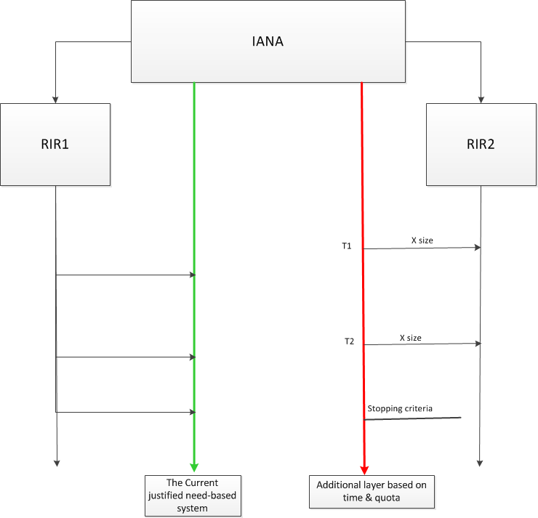

Slide 9
Conclusion
HI justifies concerns but not necessarily a change to an ITU-based regime.
NRO’s claim regarding the RIR’s success overlooks the interdependence of events in history.
Embracing the concerns sends strong political message.
Size of IPv6 offers the required flexibility to experiment with alternative policy ideas within the existing regime.

Slide 10
Further reading?
http://www.tandfonline.com/doi/full/10.1080/19331681.2013.873362#.U2NsGrSwF6M

Slide 11
References
Hall , P,. and Taylor, R. R . 1996. “Political Science and the Three New Institutionalisms” Political Studies, XLIV, 936-957.
Huston, G. 2005. “Just how big is IPv6? - or where did all those addresses go?” The ISP Column, July, 2005. http://www.potaroo.net/papers/isoc/2005-07/ipv6size.pdf.
Mueller, M. 2005. “Competition in IP addressing: A Review of the Debate.” IGP Concept Paper. http://www.internetgovernance.org/wordpress/wp-content/uploads/igp-v6.pdf.
Mueller, M. 2009. “Economic factors in the allocation of IP addresses.” Paper presented at Telecommunication Standardization Bureau (TSB)- ITU, March 15-16, 2010, Geneva Switzerland http://www.itu.int/dms_pub/itu-t/oth/3B/02/T3B020000020003PDFE.pdf.
Meinrath, S.D., Losey, J.W., and Pickard, V.W. 2011. “Digital Feudalism: Enclosures and Erasures from Digital Rights Management to the Digital Divide.” 19 CommLaw Conspectus 423, 1-46.
NRO. 2004. “NRO response to ITU comments on the management of Internet protocol (IP) addresses.” NRO Document ID: NRO17. http://www.nro.net/wp-content/uploads/2004/11/nro17.pdf
Peters, B.G (2nd eds). 2005. Institutional Theory in Political Science: the New Institutionalism. Hampshire: Ashford Color Press Ltd.
Steinmo, S. 2008. “Historical Institutionalism.” In Della Porta, D. and Keating, M. (eds), Apporaches and Methodlologies in the Social Sceince: A Pluralist Perspective. Cambridge University Press, 118-138.
Woodyatt, J. 2011. “IPv6 doesn’t have as much address space as you think.” Dreamwidth Studious, February 14, 2011. http://jhw.dreamwidth.org/1650.html.

