Slide 1
Tradeoffs in Network Complexity

Slide 2
Introducing Complexity
“It won’t scale”
“It’s not elegant”
These are statements about complexity
“Reduce complexity,” right?

Slide 3
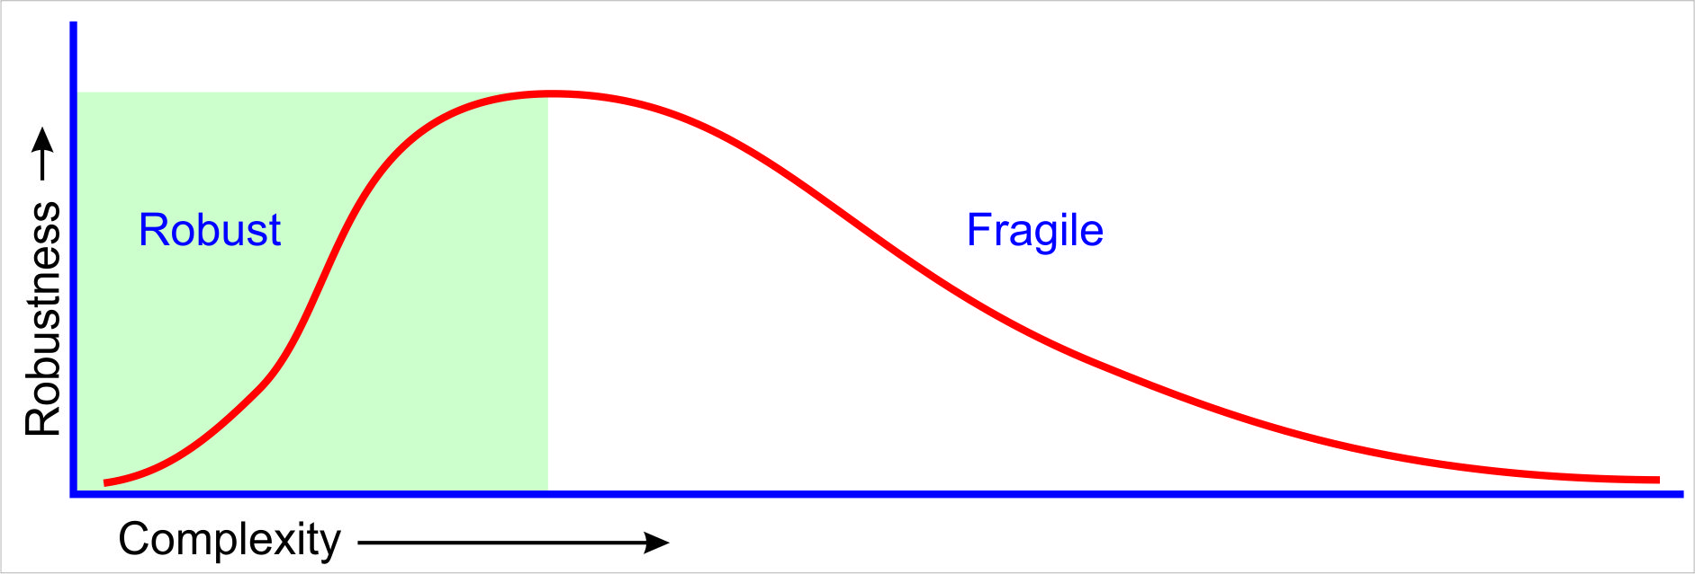
Network Complexity is Necessary
Complexity is necessary to build robust systems
We can’t get away from complexity…
chart after Myers

Slide 4
Network Complexity is Necessary
“In our view, however, complexity is most succinctly discussed in terms of functionality and its robustness. Specifically, we argue that complexity in highly organized systems arises primarily from design strategies intended to create robustness to uncertainty in their environments and component parts.”
See Alderson, D. and J. Doyle, “ContrasDng Views of Complexity and Their ImplicaDons For Network-­‐Centric Infrastructures”, IEEE TRANSACTIONS ON SYSTEMS, MAN, AND CYBERNETICS—PART A: SYSTEMS AND HUMANS, VOL. 40, NO. 4, JULY 2010
Notes:
We add complexity to resolve real problems, and create real value
However, adding complexity means that while the system is better able to respond to some things, it is less able to respond to others

Slide 5
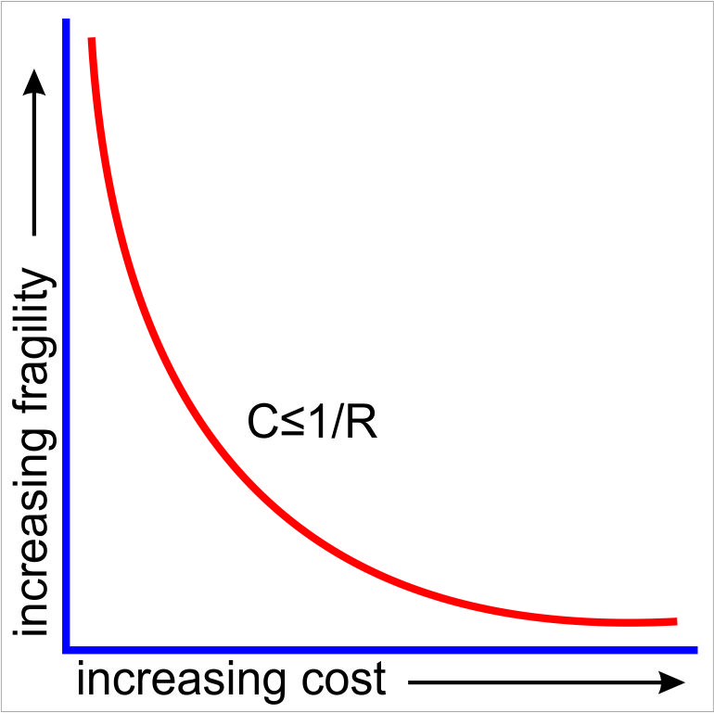
Complexity is Impossible to Solve
We cannot get to the lower left hand corner
There is a “sweet spot,” where the optimal robustness is paired with the lowest cost
RYF, CAP, QSC, etc. are all symptoms of this problem
Impossible!
chart after Myers
Notes:
RYF: Robust Yet Fragile – see Meyer, et. Al
CAP: CAP Theorem – Consistent, Accessible, Paritionable, choose two
QSC: Quality, Speed, Cost, choose two

Slide 6
Network Complexity is Organized
Organized complexity is different than disorganized complexity
They are all problems which involve dealing simultaneously with a sizable number of factors which are interrelated into an organic whole. They are all, in the language here proposed, problems of organized complexity. –Weaver, 1948

Slide 7
Network Complexity is Organized
Statistical models will be of limited use in this realm
  Statistics will tell you if there is information (Shannon), but not what that information means
We must interact with intent
  Network design intends to solve specific problems
  How can you measure intent?

Slide 8

So…
Complexity in networks is necessary
Complexity in networks is impossible to solve (perfectly)
Complexity in networks is difficult (or impossible) to measure and characterize
Abandon hope all ye who enter here?
Or maybe…

Slide 9
Complexity as a Tradeoff

Slide 10
Complexity as a Tradeoff
Maybe we look at complexity as a set of tradeoffs
  Increasing complexity to increase robustness at point a will lead to decreased robustness at point b
  Reducing complexity at point a will cause complexity at point b to rise
So…
  Find the tradeoffs and describe them
  Find ways to measure both sides of each of the tradeoff
  Make better (more intelligent) decisions about design
Let’s consider a few examples

Slide 11

Complexity verses the Problem
Harder problems tend to require more complex solutions
  Complexity has no meaning outside the context of the problem being solved
  Nail verses screw verses screw+glue
How many balloons fit in a bag?

Slide 12

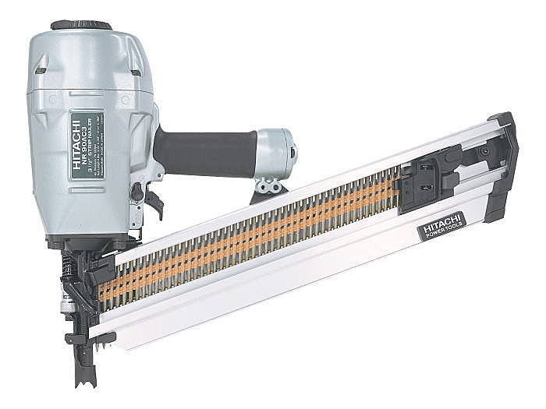

Complexity verses the Toolset
More complexity can be managed with better tools
  If your only tool is a hammer…
But we need to figure in the cost of the tool
  Nail guns are harder to maintain than hammers
  Sonic screwdrivers are notorious for breaking at just the wrong moment

Slide 13



Complexity verses Skill Set
Things that are complex for one person might not be for another…
  This isn’t a (just) matter of intelligence, it’s also a matter of focus and training

Slide 14
Complexity verses Complexity
Complexity comes in pairs
  It is easier to move a problem around (for example, by moving the problem to a different part of the overall network architecture) than it is to solve it.
  It is always possible to add another level of indirection.
  RFC1925
Decreasing complexity in one part of the system will (almost always) increase complexity in another

Slide 15
The Complexity Graph
Complexity
Sweet Spot
Function
Counter-complexity
Simple!

Slide 16

The Point
You can never reach some other desirable goal without increasing complexity
  Decreasing complexity in one place will (nearly) always increase it in another
  Decreasing complexity in one place will often lead to suboptimal behavior in another
  Increasing service levels or solving hard problems will almost always increase complexity
You don’t have to have a point, to have a point…

Slide 17

The Goal
Bad questions
  How complex is this?
  Will this scale?
Good questions
  Where will adding this new thing increase complexity?
  If I reduce complexity here, where will I increase it?
  If I reduce complexity here, where will suboptimal behavior show up?
Complexity at the system level is about tradeoffs, not absolutes

Slide 18
Fast Reroute as an Example

Slide 19
Precompute
192.0.2.0/24
Router A uses the path through B as its primary path to 192.0.2.0/24
There is a path through C, but this path is blocked by the control plane
  If A forwards traffic towards 192.0.2.0/24 to C, there is at least some chance that traffic will be reflected back to A, forming a routing loop
We would like to be able to use C as an alternate path in the case of a link failure along A->B->E
E
B
D
C
A

Slide 20
Precompute: LFAs
192.0.2.0/24
Loop Free Alternates (LFAs)
  A can compute the cost from C to determine if traffic forwarded to 192.0.2.0/24 will, in fact, be looped back to A
  If not, then A can install the path through C as a backup path
Gains
  Faster convergence
Costs
  Additional computation at A (almost nil)
  Designing the network with LFAs in mind
E
B
D
C
A

Slide 21
Precompute: Tunneled LFAs
192.0.2.0/24
Tunnel into Q
  A can compute the first hop beyond C where traffic destined to 192.0.2.0/24 will not loop back
  A then dynamically builds a tunnel through C to this point and installs the tunnel interface as a backup route
  There are a number of ways to do this
    NotVIA, MRT, Remote LFA, etc.
    Different computation and tunneling mechanisms, but the general theory of operation is the same
E
B
D
C
A

Slide 22
Precompute: Tunneled LFAs
192.0.2.0/24
Gains
  Relaxed network design rules (rings are okay)
  Eliminates microloops
  Faster convergence
Costs
  Additional computation at A (almost nil)
  Some form of dynamic tunnel
  Additional control plane state
  Designing the network with alternate paths in mind
    These mechanisms don’t support every possible topology (but more than LFAs)
    Thinking about alternate traffic patterns to project link overload, QoS requirements, etc.
E
B
D
C
A

Slide 23
Whither Complexity?

Slide 24
Whither Complexity?
Will we ever have a single number that tells us how complex a network is?
  Probably not
  But we will have a bunch of numbers that help us characterize specific parts
Will we ever have something we can point to that will mathematically prove, “this is complex,” “that won’t scale,” etc.?
  No…
  But we can understand what complexity looks like so we can “see” elegance more clearly

Slide 25

Whither Complexity?
One useful result would be a more realistic view of network design and operation
We’re caught on multiple pendulums
  Centralize! Decentralize!
  Layer protocols! Reduce protocol count!
Most of these swings relate to our absolute view of complexity
  There must be a better solution!
  Let’s go try that over there! (shiny thing syndrome)
If we could gain a realistic view of complexity, we might be able to see how to at least reduce the frequency and amplitude…

Slide 26
One Way Forward
Measurements within a framework
  Understand the system as a whole
  Think about how to measure each point
  Think about how to compare, or weigh, each pair of points
Document the tradeoffs we find in real life
  Helps guide the work of developing measurements
  Helps build a “body of knowledge” that will drive the state of the art in network design forward

Slide 27
Efforts to Measure & Describe
Network Complexity Working Group (NCRG)
  IRTF working group
  Trying to find ways to describe and measure complexity
  Gathering papers in the network complexity space on networkcomplexity.org
draft-irtf-ncrg-network-design-complexity-00.txt
  Within NCRG
  Parallel to this presentation
Many other efforts afoot

Slide 28
The End!

